Slide 1
Researching the center
ALBERT Fanny, HUBERT Marie, JADIN Benoît
Helmo Liège Belgium
Notes:
Last year, within the context of their final thesis to become secondary mathematics school teachers, Mary and Fanny have studied the central values and experimented various activities in classrooms. They’ll talk about these experiments and we’ll broaden the discussion on that basis.
In our presentation, we distinguish average and mean : ” the average refers to several different measures of center : mean, median, mode, midrange.”

Slide 2
Prelude
Do the citizens really understand the data supplied by the society ?
A questionnaire including
7 multiple choice questions with a space for comments
186 people aged between 16 and 84
1) mathematics teachers (of the lower and upper secondary level) and primary school teachers (9);
2) pupils of the fifth year of secondary school with a course program oriented towards mathematics (28);
3) students of the Bachelor program (year 1, 2 or 3) in mathematics (34);
4) neutral public , ordinary people (115).

Slide 3
Average number of ears : how do you react if you are told that more than 99 % of people has more ears than the average of the number of ears ? It seem’s strange, but it's true.
1.The poll was made on a population with many handicapped persons who lost an ear.
2. If we take 5 persons including one with only one ear it's true, but if we take the same example with 10 000 people, it will not work.
3. It is impossible.
Propositions | Neutral public | Math teachers | Secondary school | High school
1 | 12 % | 33 % | 7 % | 12 %
2 | 16 % | 0 % | 7 % | 18 %
3 | 30 % | 0 % | 54 % | 26 %
Correct answer | 20 % | 67 % | 18 % | 38 %

Slide 4
Average number of ears : how do you react if you are told that more than 99 % of people has more ears than the average of the number of ears ? It can seem strange, but it's true.
« It is true because only some people should have a single ear for the average to be lower than 2 ears. In this case, 99 % of people have more ears than the average of the number of ears. »
« So logical... If an imbecile cut itself the ear, the average will be smaller than 2. Except if one other imbecile is born with 3 ears. And if there is the same number of imbeciles in both camps, the average stays for 2. »

Slide 5
Inhabitants per square kilometer : in Russia, on 1st January 2015, 146 267 288 inhabitants were considered as living there. Nevertheless, the number of inhabitants per km² is 8.4. By contrast, in Japan, where 127 103 388 inhabitants were counted in 2014, we observe a population density of 349 inhabitants per km². How to explain it ? What can be concluded ?
1. Every Russian has 8.4 km² for himself.
2. There are many uninhabitable zones in Russia.
3.In Japan, we count 349 Japanese on each km² .
4. They miscounted the number of inhabitants.
5. The differences in the number of inhabitants per km² were too important for the population density to be accurately calculated.
Propositions | Neutral public | Math teacher | Secondary school | High school
1 | 4 % | 11 % | 7 % | 0 %
2 | 68 % | 78 % | 71 % | 67 %
3 | 20 % | 11 % | 46 % | 26 %
4 | 1 % | 0 % | 0 % | 3 %
5 | 1 % | 0 % | 0 % | 0 %
Correct answer | 36 % | 22 % | 29 % | 24 %

Slide 6
Inhabitants per square kilometer : in Russia, on 1st January 2015, 146 267 288 inhabitants were considered as living there. Nevertheless, the number of inhabitants per km² is 8.4. By contrast, in Japan, where 127 103 388 inhabitants were counted in 2014, we observe a population density of 349 inhabitants per km². How to explain it ? What can be concluded ?
« Russia has a larger surface area, but the population is concentrated in certain places. There are thus square kilometers where there is 0 population, which results in a drop of the average. »

Slide 7
Which score: in the United States, at the end of the secondary school, all the pupils have to take a general common examination called SAT (what means Test of School capacities). The average score obtained at this test was calculated based on a large number of schools of the country. This average score is 400. We randomly selected 5 pupils and recorded their results. The scores of the first four pupils are the following ones: 380, 420, 600 and 400. What is the most likely score for the fifth pupil
1. 200
2. 400
3. 410
4. All the scores are
possible.
5. It is not possible to answer
the question.
Propositions | Neutral public | Math teacher | Secondary school | High school
1 | 35 % | 22 % | 25 % | 41 %
2 | 3 % | 0 % | 4 % | 3 %
3 | 1 % | 0 % | 4 % | 0 %
4 | 57 % | 78 % | 57 % | 59 %
5 | 19 % | 11 % | 32 % | 12 %
Correct answer | 7 % | 22 % | 0 % | 3 %

Slide 8
Which score: in the United States, at the end of the secondary school, all the pupils have to take a general common examination called SAT (Test of School capacities). The average score obtained at this test was calculated based on a large number of schools in the country. This average score is 400. We randomly selected 5 pupils and recorded their results. The scores of the first four pupils are the following ones: 380, 420, 600 and 400. What is the most likely score for the fifth pupil ?
« We could think of a score of 200, but the sample is too small to have a strong probability that the average of the sample approaches the average of the population. »

Slide 9
Data processing, Statistics : what happens at school ?
Notes:
Following the analysis of the questionnaire, we realize that, whatever their age, numerous individuals are poorly equipped from a statistical point of view. Particularly with regard to the central values which do not seem to be mastered in depth. It is the reason why we consulted the programs of the beginning of the secondary school, as well as certain textbooks, and we collected some testimonies concerning the practice used within the classrooms.

Slide 10
Programs for the first three years of secondary school (ages 12-14)
calculate the mean and the mode
the median being often postponed to a later stage in the program
compare populations or samples
Lack of demand
for analyses arising from statistical studies
for the learning of central values in depth : uses, advantages and limitations

Slide 11
Textbooks
The mean is generally seen only as the result of a calculation and asked in a very abstract way, without any sense or context
The data only in the form of tables already indicating absolute frequencies, relative frequencies, cumulative frequencies
(the big wealth of statistics is actually to handle a raw series of data, to order them, to classify them, to analyze them, to compare them, to interpret them and to finally draw conclusions based on the previous steps)
Most of the exercises are inserted a little bit artificially into poor contexts.
(instead of proposing real situations involving statistics and why not, with a citizen vocation, the problems are disguised, what causes a lost of meaning from the educational point of view)

Slide 12
Textbooks
During the construction of graphs, the pupils are often required to realize one type of graph
(whose shape, axis for the Cartesian, circle for circular, is sometimes drawn, what does not let the learners think about the scale to be used, for example
while it would be more instructive and more sensible to let the pupils choose the adequate graph and to make them justify their choice)
In the practice of the classrooms
It turns out that the chapters about data processing are sometimes (maybe often) placed at the end of the year, or even deleted due to the lack of time, if not given to the pupils in autonomous work.
Notes:
Textbook : the research and analysis work is thus simplified and a part of the interest of statistics is lost.

Slide 13
Senses & uses
In varied contexts to birth the concepts
Notes:
This part owes much to Arthur BAKKER (from the Freudenthal Institute of Utrecht) and Claudine SCHWARTZ (from the University of Grenoble). Thank you to them

Slide 14
Central values
To describe a population (in the statistical sense) with regard to a given variable.
Example: "it is necessary to commute one hour to go from Liège to Brussels. »
To compare various populations
Example: international tests like PISA
To be located within a population
Example: a result obtained in a test will be compared with the average of the class
To represent a population
Example: "a grown-up giraffe weighs 830 kg, has a size of 4,6 m and a 60 kph speed." (Claudine SCHWARTZ, L’empereur et la girafe)
Do all the giraffes weigh 830 kg and measure 4,6 m ? Do they permanently move at 60 kph ? Is it their top speed ? How to interpret these results ?

Slide 15
Central values
To eliminate fluctuations :
" We have to, above all, lose sight of the man taken in isolation, and consider him only a fraction of the species. By stripping him of his individuality, we shall eliminate all which is only accidental; and the individual peculiarities which have only few or no action on the mass will fade of themselves, and will allow to seize the general results."
(A. Quetelet, Sur l’homme et le développement de ses facultés ou Essai de physique sociale, Tome premier, Bachelier imprimeur-libraire, Paris, 1835. Downloaded on the site http://gallica.bnf.fr )
Notes:
De façon globale…

Slide 16
Mean
To reduce the errors, for example in measurement problems to approach the real value of a size.
To estimate the size of an important population
Examples:
Former use : estimation of the number of leaves on the branch of a tree. To achieve it, a man has selected a single twig (that we do not imagine chosen at random) and has multiplied the number of present leaves on this one by the number of twigs on the branch.
Modern use : estimation of the number of participants during a demonstration through the selection of a cell representative of the people distribution within a grid system.
Notice that these first two uses are also valid for the median.

Slide 17
Mean
To distribute evenly
Representation of the size that would take each element of a series of data if they were all identical.
Sense of the sum of the values :
Exemples : payroll, wealth of the population
Counter exemple : temperatures

Slide 18
Mean
Attention on the nonsense
There are different ways of interpreting the average according to the usage that is made :
- any sense to wonder what would be the size of each pupils of a classroom if all of them had the same size
but
- using this mean to characterize the average pupil has a sense, because each of them can be located in the classroom and we could also compare them with each other.

Slide 19
Mean
Barycentre, center of gravity, balance (or pivotal) point
Two values
- Same frequencies - Different frequencies
Notes:
x- axis is an horizontal bar. Each frequency (or vertical bar) is a weigt.
Same frequencies : the pivotal point is just in the middle between both values.
The frequencies are not any more the same and one equals three times the other, the lever arms have to be in the same proportion and are respectively equal to ¾ and ¼ of the distance between both values.

Slide 20
Mean
Several values

Slide 21
Mean
Symetric distribution, the pivotal point is in the centre of the distribution.
The weights change, this pulls the mean where the weights become more important.
The weights remain the same but the values change, the mean follows the value movement.

Slide 22
Mean
To minimize the square deviation
For a statistical series a = (a₁, a₂, ... a_{n}) :
the dispersion of the squared deviation around any number x as being
We obtain a function of the second degree
Notes:
We can say that the average has to be " the closest possible to all the numbers of the series ". What means the closest possible ?
From the point of view of “squared deviation” …
We obtain a function of the second degree.
The minimum is ... The mean.

Slide 23
Midrange
The mean of the smallest and the highest value of a dataset.
Its main advantages are its ease and speed of calculation, and its intuitive side.
Historically, an use of the midrange consisted in estimating the number of crew members of a fleet. Indeed, the purpose was to first identify the two boats containing the fewer and the more sailors and then to make the average of these two extremes values. (Arthur Bakker and Koeno P. E. Gravemeijer , An Historical Phenomenology of Mean and Median in Educational Studies in Mathematics, Springer Netherlands, Volume 62, Number 2, june 2006 )

Slide 24
Median
To provide a richer source of information, which still remains readily available (boxplot or « boîte à moustache »)
The prince of Tuscany once asked Galilee: why when rolling three dices, do we obtain more often a total of 10 rather than a total of 9, although these totals are both achieved in six different ways ?
We simulated the experiment with a spreadsheet. It is faster than carrying out the experiment in reality. We first considered 20 series of 10 rolls . Then, 20 series of 100 rolls. And finally, 20 series of 1000 rolls.
Notes:
Moustaches : whiskers

Slide 25
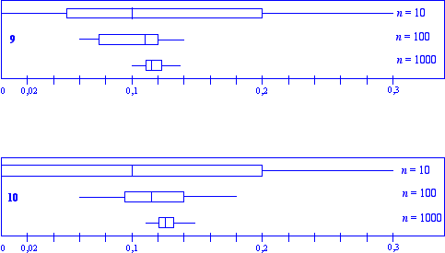
25 %
25 %
25 %
25 %

Slide 26
Median
To estimate the chances : good half
John Graunt (or another one : Petty ?) established mortality tables of the London population at the beginning of the seventeenth century. (Natural & Political Observations Upon the Bills of Mortality… of the City of London de 1662).
August 22nd, 1669, Louis Huygens (in Holland) raises the question to his brother Christian (in Paris) : « up to what age has a child to naturally live as soon as he is conceived ? » (Œuvres complètes de C. Huygens, Tome 6 in Gallica http://gallica.bnf.fr/Catalogue/noticesInd/FRBNF38949978.htm)

Slide 27
Median
To estimate the chances : good half
Louis's calculation corresponds to the average lifetime, what we call “life expectancy” in a modern language.
Whereas Christian's solution, starting from an robustness argument, bases on the median. At a given age, with a given number of survivors, he considers the time period over which the population has dropped by half.

Slide 28
Median
To divide the total height of the bars into two equal parts

Slide 29
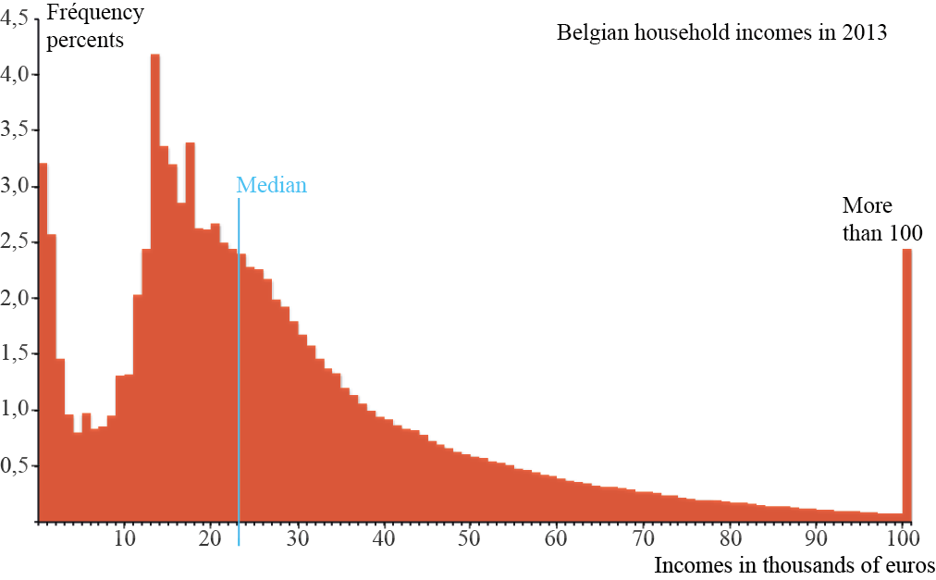
To divide the surface area into two equal parts
Histogram
Notes:
Net taxable incomes for a year.

Slide 30
Median
To minimize the absolute deviation
For a statistical series a = (a₁, a₂, ... a_{n}) :
the dispersion of the absolute deviation around any number x as being
It’s a linear piecewise function.
What value of x minimize this function ?
Notes:
We can say that the average has to be " the closest possible to all the numbers of the series ". What means the closest possible ?
But now, it’s from the point of view of “absolute deviation” …

Slide 31
Median
Let us take an example of educational outcomes on a total of 20
Notes:
From the point of view of squared deviation, the mean is better (or closer the values) than the median.
From the point of view of absolute deviation, the median is better (or closer the values) than the mean.

Slide 33
Mode
To represent the most frequent value
- In elections contexts, the choice of the majority (presidential elections in France, in the United States…).
To allow for estimation of large numbers
- In the famous Athenian time, when people wanted to calculate the height of an enemy wall, it was asked to diverse persons to count the number of bricks to obtain an estimation of the total height. To arbitrate between the different results, the most frequent value was taken, namely the mode.
Let us note that in the XVIth century, in French, the term "mode" was only feminine. Only later, the mode was distinguished from the fashion. Yet, the latter have the same meaning, the fashion translating what the majority wears, what is trendy for the moment.

Slide 34
Mode
A maximum (and a center in symmetric cases).

Slide 35
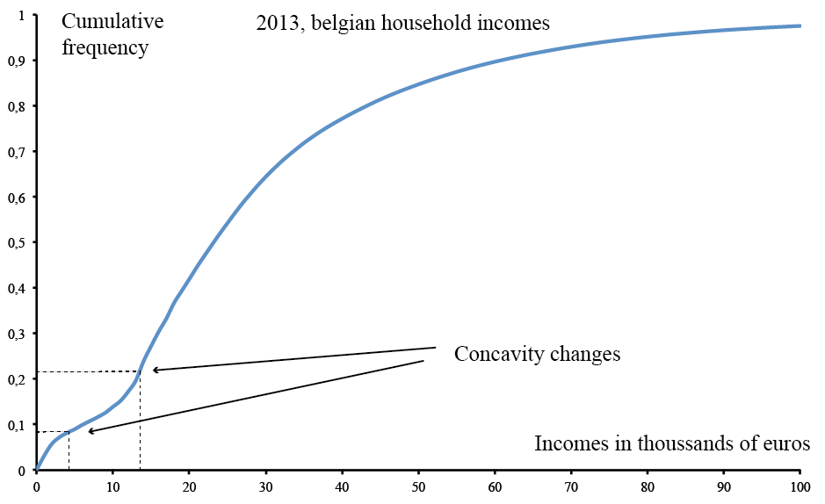
Mode
A concavity change
Notes:
We consider again the belgian household incomes (net taxable for a year).
There are two changes of concavity. The second is a maximun of growth, which is the mode. The first derivative is maximal and the second derivative nullifies.

Slide 36
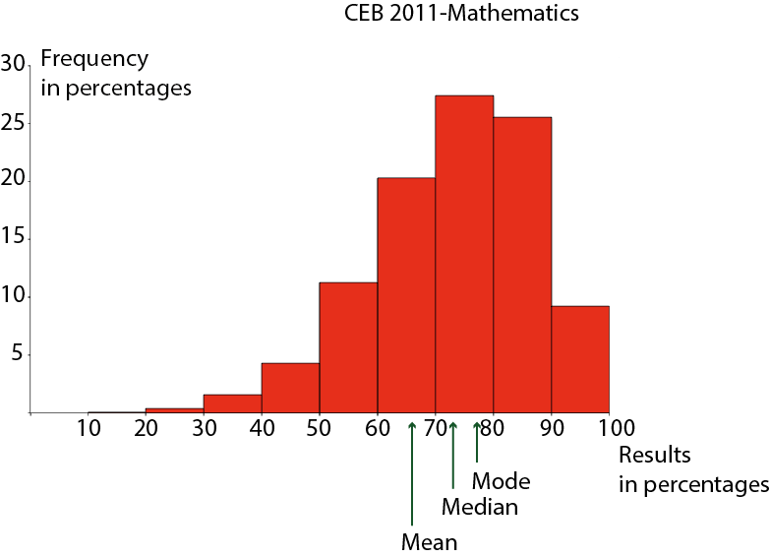
Central values : relative positions
First case
Notes:
We look at relative positions of central values.
When the three values (mode, median, mean) are equal, the “bell curve” is symmetric
The maximum is the mode (not just the middle of the class but slightly on the right as we could see by considering smaller classes).
The median cut the area in two equal parts, it’s on the left.
The mean follow little values and is pulled on the left.
The curve spreads toward the left
The mode is higher than the median, which is higher than the mean.

Slide 37
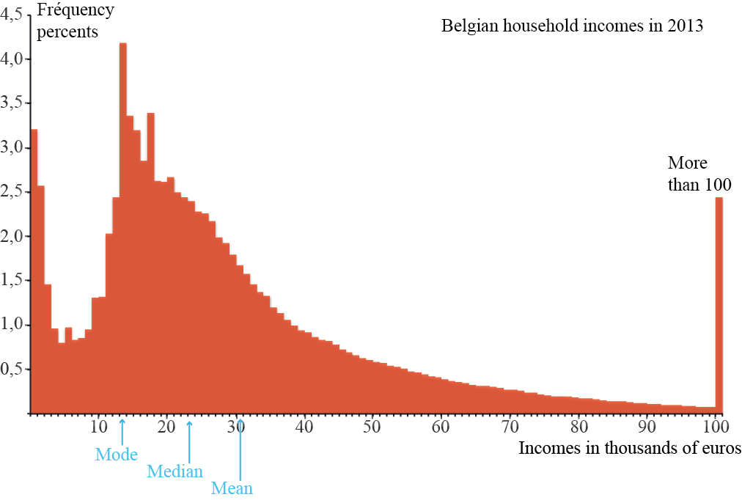
Central values : relative positions
Second case
Notes:
The maximum is the mode
The median cut the area in two equal parts, it’s on the right.
The mean follow big values and is pulled on the right.
The curve spreads towards the right
The mode is lower than the median, which is lower than the mean

Slide 38
In the classrooms
First steps in statistics

Slide 39
During the school year 2015-2016, we carried out our experiments in classes of :
5th and 6th years of primary school ;
1st year of secondary general school ;
3rd and 4th years of professional education ;
4th year of technical school.

Slide 40
Designation of a delegate
You have to choose a delegate to represent your class during class councils. Describe your method and your observations. .
Choices :
The mode is more meaningful in a decision-making context
The will of the majority is decisive
To initiate a debate on what seems right, fair, democratic…

Slide 41
Designation of a delegate
You have to choose a delegate to represent your class during class councils. Describe your method and your observations. .
Results :
Several pupils suggest realizing posters the same way you would do for an election campaign
The first topic for the pupils was the selection criteria’s leading to the choice of the “right” candidate
When the outcome is known, if somebody does not agree, the debate can start again and results into a second vote (idea of the electoral tour in France for instance).
Each pupil allocates individually the total i.e. 100 %, between their favourite candidates.

Slide 42
« On prend son pied ! »
What is shoe size of the pupil of the class who has as many peers whose shoe size is smaller than his, as peers whose shoe size is bigger ? Describe your method.
Choices :
We did not want to insert the expression “value of the middle”
We are looking for a value (size) and not an individual (median pupil).
We chose to collect the shoe size following the order of the benches
To handle the odd cases and then the even cases, we add the professor shoe size in colour.
We wanted to start from datas directly linked to pupils and easily available such as the size or the weight. However, these two might have created a certain embarrassment for some teenagers.

Slide 43
Results :
Some start by classifying the shoe sizes in the increasing or decreasing order
If we observe several times the same size, do we have to note all of them or is one time enough ? The opinions are shared…
Odd case :
Some groups start from both ends and move forward step by step until they have eliminated as many "pairs" of numbers as possible.
Others do not notice the symmetry and make the counting from the left to the right: they count five sizes on the right, jump one (the middle one) and they check that there are five as well on the other side.
Even case : two values in the middle
We take the biggest (or the smallest) value, we take the one who has the biggest (or the smallest) frequency.
Other pupils propose to choose the middle of these two values by adding them up and divide the result by 2

Slide 44
For a good cause
a) In the context of the charity organised by the foundation Damien, 4 pupils have respectively bought 18, 12, 10 and 20 pens. Distribute them fairly among them. What is the part of every pupil, before and after the sharing? Describe your method.
Choices :
Context of the pens :
Manipulation
Meaning to the calculation of the mean
Not foster envy or egoism like it could in a context of money,
Money would not have allowed us to address the characteristics of the mean
Notes:
Contexte : Répartition équitable des biens, partager avec des personnes qui possèdent moins ou rien (point de vue citoyen). Permet manipulation, donne un sens au calcul de moyenne (somme du nombre de bics à un sens), moins de jalousie et égoïsme que dans contexte d’argent. Pourquoi pas l’argent? Ne permet pas d’aborder la moyenne comme valeur non observable physiquement (12,8€ existe).
Formule par manipulation : différentes manières
Forte idée intuitive pour la formule, évident même : on additionne le nombre de bics et on divise par le nombre de personnes présentes.
Distribution : Partant de 0 ou sur une base de 10 (tout le monde aura de toute façon au moins 10)

Slide 45
Results :
We count the total number of pens and we divide it by the number of persons present
We gather all the pens in a pile and we distribute them as a game of cards, one by one
We pick some in the closest pile to complete their collection (method of compensation )

Slide 46
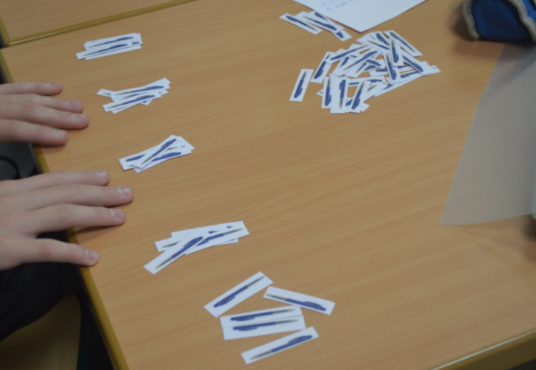
For a good cause
b) Jean-Luc, who didn’t have the opportunity to buy pens for a good cause, joins the group. What is then the new part of each pupil ? Describe your method and your observations
Choices :
Adding a null value
We expect likely oppositions
Results :
They adapt the first method to this new case
Fairly distribution (with a threshold)
Team spirit and solidarity

Slide 47
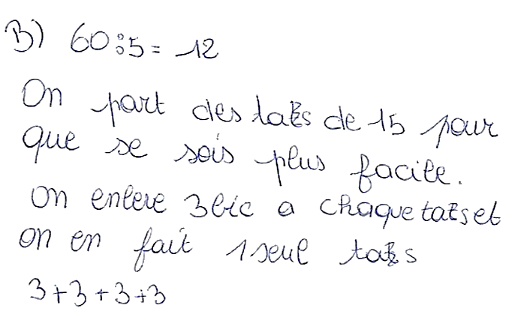
Compensation method : « starting from the previons piles (15) and, knowing that each pupil should receive 12 pens, took 3 pens from every pile to form a new one ».

Slide 48
For a good cause
c) In another group, 5 pupils bought respectively 16, 12, 8, 20 and 8 pens. Calculate the average number of pens bought by these pupils.
Choices :
The average number of pens is not an integer and is thus not a physically observable value
During the first experiment, points b) and c) were grouped in a single one : the particularities of adding a null value and of an unobservable average were encountered in the same question
These are two steps difficult to overcome and we thus though pertinent to address them separately
The pupils did not have pens at their disposal anymore

Slide 49
Results :
Once the calculation is done, here is the result: 12,8! “Oh, I made a calculation error !”. “No, it’s correct”.
Several proposals then emerged
- Remove pens so that the calculation results in a whole number
- Add pens for the same reason
- Remove or add people
Give the remaining pens to the “poor” people
Some people will possess 12 pens and some others 13
- Each pupil will have 12 pens, and the 4 remaining pens will be given to those who were present from the beginning
- The professor recovers the surplus of pens and resells them

Slide 50
What value to choose?
During a dinner, a group of 10 friends played a tournament of darts. The table give the results. What is the most representative result of the game level of the group of friends ? Justify your choice by describing your method and observations.

Slide 51
Choices :
This last workshop requires the use of three notions previously presented (mode, median and mean), their comparison and the selection of the one that will be the most representative of the given situation.
An extreme value (251, score of Romane), in particular to show that the mean is not a robust value
A multimodal series (indeed, 37 and 41 appear twice)
The raw data (in the form of a table) asking for a classification
A debate on the validity of these different values in the present situation and on whether Romane is accepted or not.
Other examples of changes affecting certain scores will be proposed so that we can indentify the potential ongoing difficulties (example: if Romane had not obtained 250, but 0).

Slide 52
Results :
A representative value is a value that can be observed
The presence of the Romane’s score doesn’t shock anybody before we point it out
- Some people want to divide the Roman’s score by two
The pupils understand the notion of "representativeness" in several different ways.
- For some, the most representative score of the classroom is the one of Romane, because it is the highest.

Slide 53
Results :
We observe two modes: so what can be done
Select the smallest, the largest, the mean of the modes, take the value 41 because 37 is too small (subjective reason). A pupil also suggests performing this calculation :
(2 × 41 + 2 × 37)/4
No one is surprised by the particularly high average (62,7), which results from the presence of the extreme value
- In some groups, they calculate the average with and without Romane to see the difference
We reach the conclusion that, in the case in point, the median seems to be a more representative value than the mean, as the first one is closer to the majority of the scores

Slide 54
Limits
Why to go further ?
Notes:
5 min

Slide 55
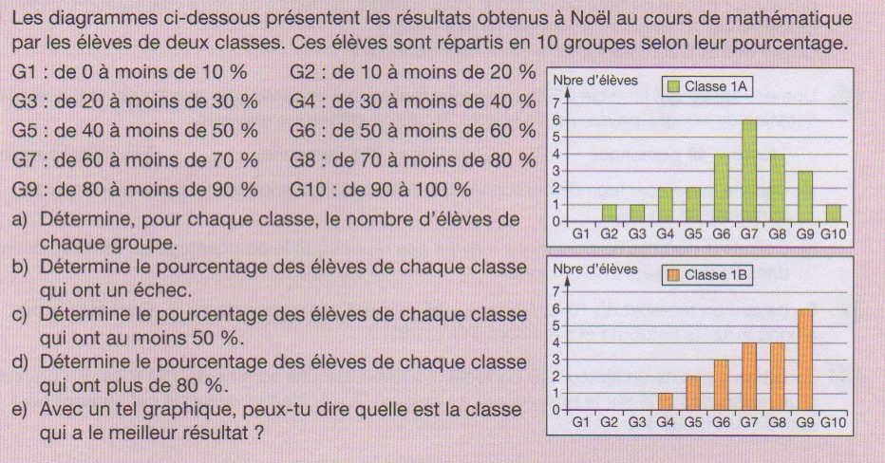
A question so simple
From the belgian textbook : “Ph Ancia, M. Bams, M. Colin, P. Dewaele, F. Huin, A. Want, Actimath à l’infini 1, Cahier d’activités, Van In, Wavre-Wommelgem, 2013.
Notes:
The figures show the results of two classes. What is the best ?

Slide 56
Students’ answers (high school, level bac +3, for becoming mathematics teacher) :
“The class 1B is the best one, because it is characterized by the lowest failure rate and the highest percentage of scores above 80%.”
“What's the meaning of « better than » ? The largest mean ? The lowest failure rate ? The highest maximum ? “
“The class 1B seems to achieve better scores because the dispersion is lower and the values are around G7 and G8.”

Slide 57
Computing the central values
 | Class A | Class B
mean | 60,83 | 68
median | 63,3 | 80
mode | 65 | 85
Notes:
The class B seem to be the best.

Slide 58
From the cumulative frequencies graph
Notes:
Until 90 % ; the curve of the class 1B is lower than the curve of the class 1A. The class B is the best, isn’t it ? There are less pupils under 40 %, 50 %, 60%...

Slide 59
Hypothesis test
We consider two random variables :
The following hypotheses are tested using a significance level
Not normal distributions, the standard deviations are not known and are supposed unequal. We consider the Student t-test
From the statistic table, we can compute the means and the standard deviations of the samples :

Slide 60
Notes:
The observed différence of the means is in the confidence interval.

Slide 61
H₀ is accepted. We cannot assert that there is a statistically significant difference between the classes. How to explain that the first intuition was not the good one ? It is due to the relatively important standard deviations. For the first class, this deviation is equal to 19,98 and for second, to 15,59. The difference in the averages (68-60,83 = 7,17) is lower than these two values, what means that the dispersal of the scores in each of the classes is larger than the difference between the two classes …
The central values are powerful tools and allow to handle numerous problems, but they have their limits as we’ve seen with this last example.

